Slide 1
Learning
Strategies

Slide 2
Suppose you’re trying to review some recent material.
Which do you think is more effective?
Study it again
Test yourself
on it

Slide 3
A study
Students were given a passage to read.
01
They then had the option of restudying the passage or taking a recall test, where they wrote down as much as they could remember from the passage.
02
After some time, they were given tests to see how much they remembered.
03
Notes:
https://journals-sagepub-com.ezp-prod1.hul.harvard.edu/doi/full/10.1111/j.1467-9280.2006.01693.x

Slide 4
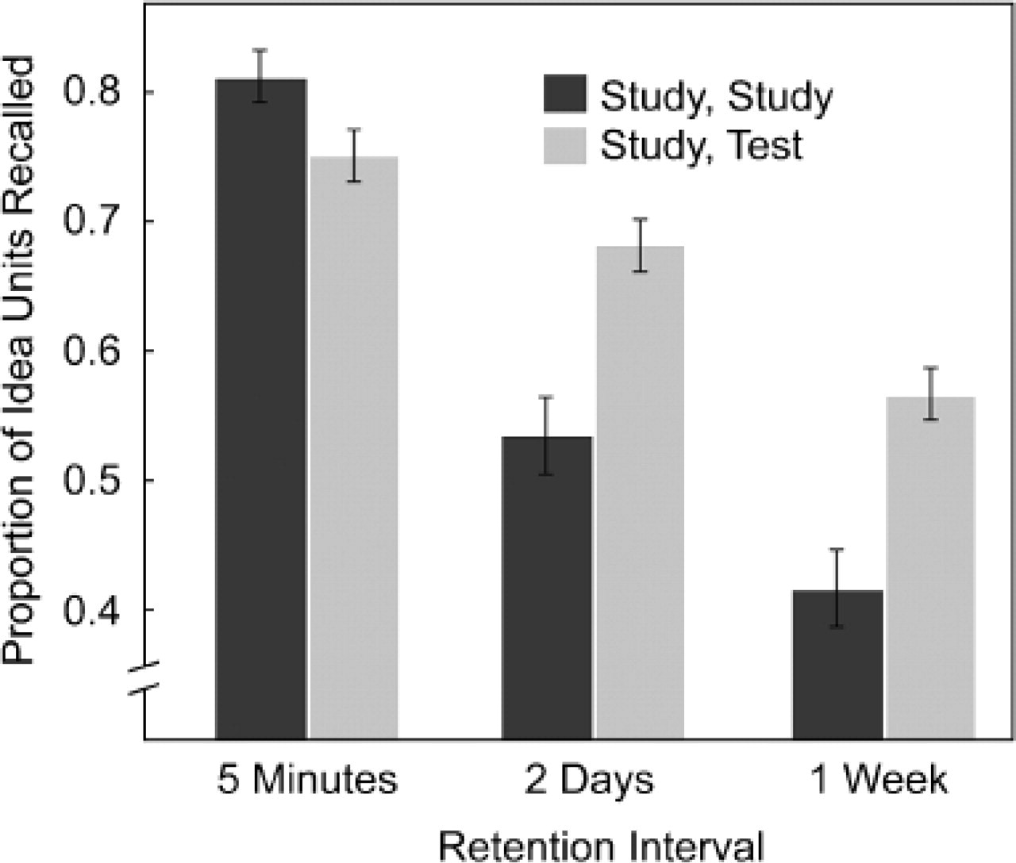
Result
Notes:
https://journals-sagepub-com.ezp-prod1.hul.harvard.edu/doi/full/10.1111/j.1467-9280.2006.01693.x

Slide 5
Testing yourself is more effective, so let’s try it!

Slide 6
Tip: use homework as an opportunity to test yourself!
1
Take a quick look over your class notes.
Put your notes away, and try the homework.
2

Slide 7
Tip: use homework as an opportunity to test yourself!
1
Take a quick look over your class notes.
Put your notes away, and try the homework.
2
3
If you get stuck, look back at your notes for something similar, but don’t follow it line by line.
Instead, try to understand the similar problem, then look away and try your problem again.
4

Slide 8
Tip: use homework as an opportunity to test yourself!
1
Take a quick look over your class notes.
Put your notes away, and try the homework.
2
3
If you get stuck, look back at your notes for something similar, but don’t follow it line by line.
Instead, try to understand the similar problem, then look away and try your problem again.
4
5
If you’re still unsure, talk with someone else!
Notes:
Important note to mention: Many students will balk at step 2 - they won’t feel “ready” to apply understanding to the homework without following line by line. Ultimately the challenge presented by trying to recall (Step 3) is an important part of longer lasting memory. The key is the retrieval practice, which doesn’t happen with the notes out.

Slide 9
Thanks to Slidesgo and Freepik for this template.

